Slide 1

SOFTWARE ENGINEERING
Indian Institute of Information Technology,Allahabad
Department of Information technology

Slide 2
INTRODUCTION
Project Demonstration
Automatic Door opening system
Group members:
Navneet singh(IIT2019056)
Gautam kumar(IIT2019087)
Ritik kumar(IIT2019088)
Subham kumar (IIT2019093)

Slide 3
GOALS
Ease the burden of security guards and management
Faster and safe entering and exit
SOFTWARE
Keep track of employees visiting
Prohibit unauthorised access

Slide 4
APPLICATION
It will allow only registered users will be able to enter the premises
It can be used in offices,schools and other places where people gather
It will send system generated mail after the timeout
It will provide a high level security

Slide 5


LANGUAGE USED
PLATFORM USED

Slide 6
MOTIVATION
WHY WE NEED THIS APP!!!
This Application will allow only registered user to enter the Building
It will also manage the time upto which any student/faculty can reside in the building
And there will be no need to take attendance as the entry/exit time will be stored in the database

Slide 7
CONTRIBUTIONS
IIT2019056-NAVNEET SINGH->Layouts, Making tab layout,One Database,Testing,Testing Doc
IIT2019087-GAUTAM KUMAR-Layouts,Placing layouts to main activity,One Database
IIT2019088-RITIK KUMAR->Layouts, Creating page adapter, Testing plan and Traceability Matrix
IIT2019093-SUBHAM KUMAR->Logic implementation and interactions,Back End,Two Database, Testing , Testing Doc

Slide 8
TESTING PLAN
TRACEABILITY MATRIX
TESTING PLAN
TRACEABILITY MATRIX TABLE
METHODS TABLE
TEST CASE TABLE

Slide 9
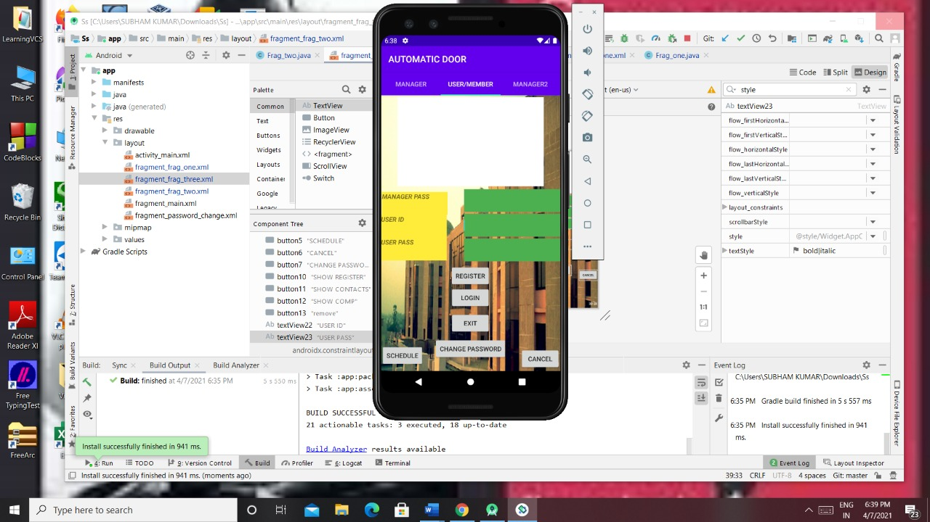
USER/MEMBER PAGE

Slide 10
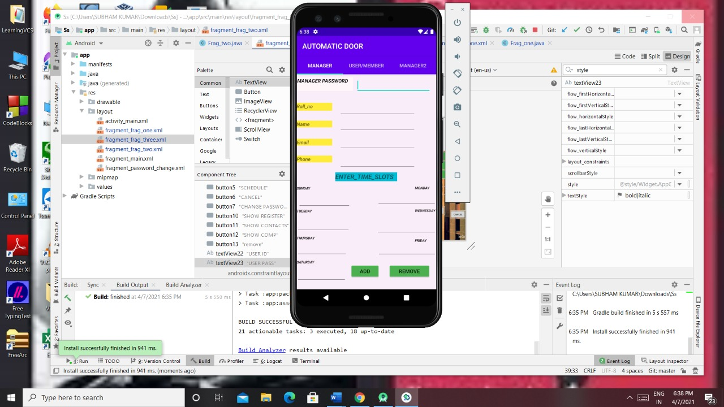
MANAGER PAGE

Slide 11
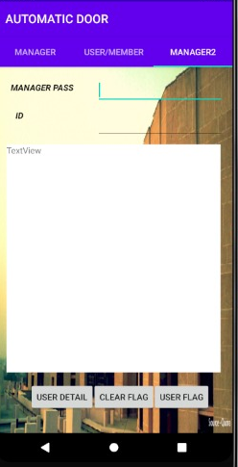
MANAGER2 PAGE

Slide 12
TEST CASE-1
USER REGISTER
In this page, the user can register himself into the database by entering his college id and password and then clicking on register button

Slide 13
TEST CASE-2
USER LOGIN
After the user gets registered successfully into the database then, the user can login by entering his ID and password and then clicking login button

Slide 14
TEST CASE-3
STUDENT EXIT
In this page,the user can exit by entering his correct id and password and then clicking on exit button

Slide 15
TEST CASE-4
USER CHANGE PASSWORD
In this page, the user can change his/her password with the help of manager.First the manager will enter his correct password and then the user will enter his Id and new password and then click on change password button

Slide 16
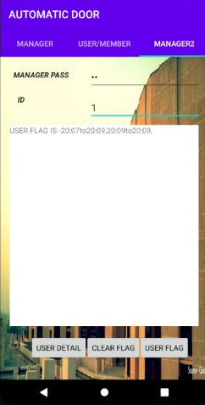
TEST CASE-5
MANAGER LOGIN
In this page,the manager can login by entering his correct password

Slide 17
TEST CASE-6
UPDATING DETAILS OF USERS
In this page, the manager will enter his password and then he’ll enter the details of that student (like user’s roll no,name,email id etc) whose details needs to be updated and then he’ll click on add button

Slide 18
TEST CASE-7
REMOVING USERS
In this page, the manager will enter his/her password then he’ll enter the enter the details of that user whom he want to remove and then he’ll click on remove button

Slide 19
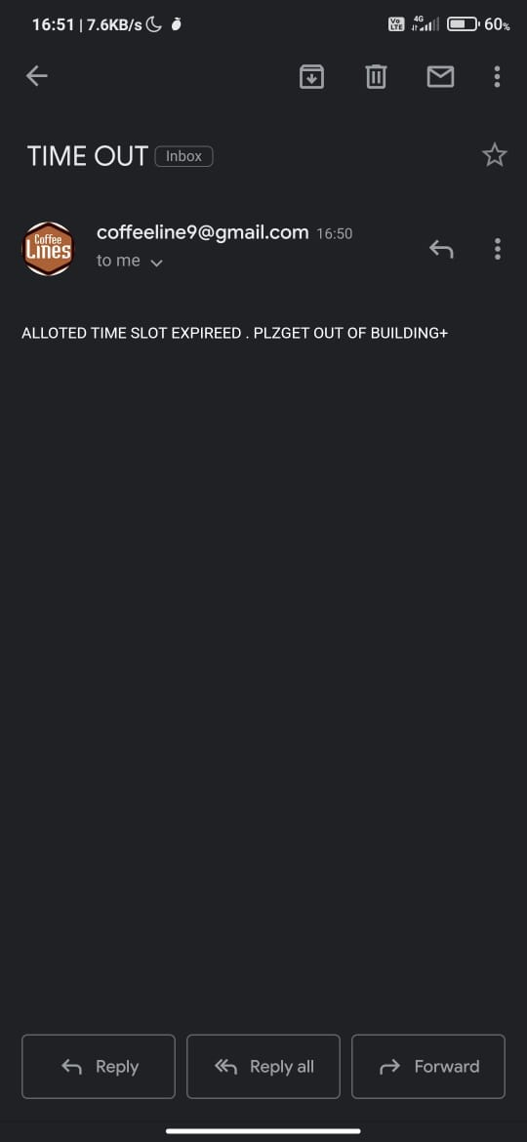
TEST CASE-10
MAIL FOR TIMEOUT
Here, a system generated mail will be sent automatically when the time allotted to the student will expire and it’ll tell the student to come out of the building

Slide 20
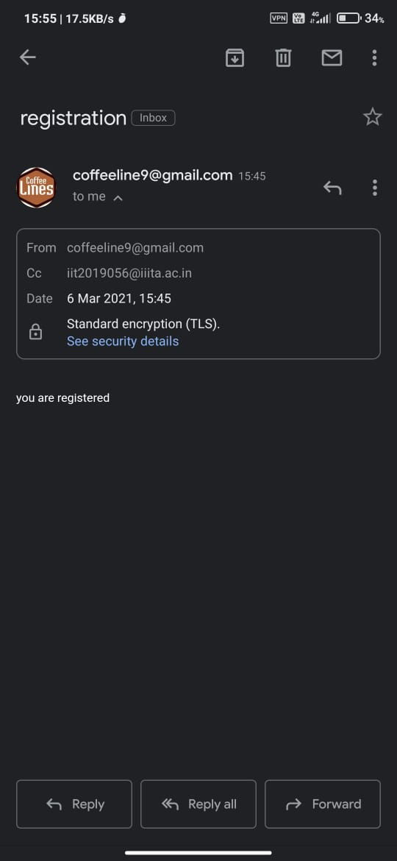
TEST CASE-11
MAIL REGISTRATION NOTIFICATION
Here, a system generated mail will be sent to the user who will register themselves into the system and that mail will say that “you are registered”

Slide 21

TEST CASE-13
MANAGER SEES THE ENTRY/EXIT TIME
In this page, the manager will enter his/her password and then he’ll enter the ID of that student whose entry/exit details he wants to see and then he’ll click on user detail button

Slide 22
TEST CASE-14
MANAGER SEES THE DETAILS OF USER
In this page, the manager will enter his/her password and then he’ll enter the ID of that student whose details he wants to see and then click on the user detail button

Slide 23
TEST CASE-15
MANAGER INSERTS DETAILS OF PERSON
In this page the manager will enter his password and then he’ll enter the details of the person (like user’s name,roll no,id etc.) which he wants to enter and then he’ll click on add to enter the details in the database

